Slide 1
What is GST?
‘G’ – Goods
‘S’ – Services
‘T’ – Tax
“Goods and Service Tax (GST) is a comprehensive tax levy on manufacture, sale and consumption of goods and service at a national level.
GST is a tax on goods and services with value addition at each stage having comprehensive and continuous chain of set-of benefits from the producer’s/ service provider’s point up to the retailer’s level where only the final consumer should bear the tax.”

Slide 2
Need for GST
Introduction of a GST to replace the existing multiple tax structures of Centre and State taxes is not only desirable but imperative in the emerging economic environment. Increasingly, services are used or consumed in production and distribution of goods and vice versa. Separate taxation of goods and services often requires splitting of transaction values into value of goods and services for taxation, which leads to greater complexities, administration and compliances costs. Integration of various taxes into a GST system would make it possible to give full credit for inputs taxes collected. GST, being a destination-based consumption tax based on VAT principle, would also greatly help in removing economic distortions and will help in development of a common national market

Slide 3
INTRODUCTION OF GST
GST is an indirect taxation in India merging most of the existing taxes into single system of taxation. It is a comprehensive indirect tax on manufacture, sale and consumption of goods and services throughout India (Except state of Jammu and Kashmir) , to replace taxes levied by the central and state governments.
Goods and services tax (GST) will subsume various indirect taxes including central excise duty, services tax, additional customs duty, surcharges, state-level value added tax and Octroi. Other levies which are currently applicable on inter-state transportation of goods are also likely to be done away with in GST regime

Slide 4
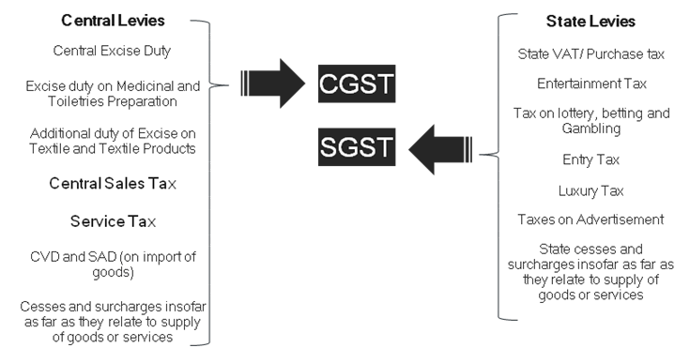

Slide 5
GST FEATURES
The tax rate under GST may be nominal or zero rated for the time being. It has been proposed to insulate the revenues of the States from the impact of GST, with the expectation that in due course, GST will be levied on petroleum and petroleum products. The central government has assured states of compensation for any revenue losses incurred by them from the date of introduction of GST for a period of five years.

Slide 6
GST – FEATURES(CONT...)
Applies to all supplies of goods / services (as against manufacture, sale or provision of service) made for a consideration except –
Exempted goods / services – common list for CGST & SGST
Goods / services outside the purview of GST
Transactions below threshold limits
Dual GST having two concurrent components
Central GST (CGST) levied & collected by Centre
State GST (SGST) levied & collected by States
CGST & SGST on intra-State supplies of goods / services in India

Slide 7
GST – FEATURES(CONT..)
IGST levied & collected by the Centre applicable to
Inter-State supplies of goods / services in India
Inter-state stock transfers of goods
Import of goods / services
Export of goods / services (if made on payment of GST under claim of rebate)
Export of goods / services – Zero rated
All goods or services likely to be covered under GST except:
Alcohol for human consumption - State Excise + VAT
Electricity - Electricity Duty
Sale / purchase of Real Estate - Stamp Duty + Property Taxes
Five specified petroleum Products – to be brought under GST from a later date on recommendation of GSTC
Tobacco Products – under GST + Central Excise

Slide 8
Registration under GST
Under GST registration, it is likely to be linked with the existing PAN.
The new business identification number was likely to be the 10-digit alphanumeric PAN, in addition to two digits for state code and one or two check numbers for disallowing fake numbers. The total number of digits in the new number was likely to be 13-14.

Slide 9
Registration under GST(CONTD…)
CASUAL REGISTRATION
A person who occasionally supplies goods and/or services in a territory where GST is applicable but he does not have a fixed place of business. Such a person will be treated as a casual taxable person as per GST.
COMPOSITION DEALER

Slide 10
TAXES UNDER GST

Slide 11
What is SGST, CGST & IGST?
Goods & Service Tax or GST will be levied on goods and services. It will replace all the various taxes and bring them under one umbrella to make compliance easier. It will replace the following taxes:
Taxes currently levied and collected by the Centre:
(i) Central Excise duty
(ii)Additional Duties of Customs (commonly known as CVD)
(iii) Special Additional Duty of Customs (SAD)
(iv) Service Tax

Slide 12
What is SGST, CGST & IGST?(CONT…)
Taxes currently levied and collected by the State:
State VAT
Central Sales Tax
Entertainment and Amusement Tax (except when levied by the local bodies)
Taxes on lotteries, betting and gambling

Slide 13
What is SGST, CGST & IGST?(CONT…)
On inter-state supply of goods and services, Integrated GST (IGST) will be collected by Centre. IGST will also apply on imports.
The GST to be levied by the Centre on intra-State supply of goods and/or services is Central GST (CGST) and that by the States is State GST (SGST).
GST is a consumption based tax i.e. the tax should be received by the state in which the goods or services are consumed and not by the state in which such goods are manufactured. IGST is designed to ensure seamless flow of input tax credit from one state to another. One state has to deal only with the Centre government to settle the tax amounts and not with every other state, thus making the process easier.

Slide 14
INVOICING UNDER GST
GST defines a transaction as ‘Supply’ when there is a transfer, exchange, rental, lease, barter, disposal or license of goods or services. Whenever a transaction takes place, a tax invoice has to be issued depending on the occurrence of any such event or within a prescribed time limit. Hence, every taxpayer registered under the GST network shall be required to issue a tax invoice for the supply of goods or services.
In the case of supply of goods, the invoices shall be raised within the prescribed time as enumerated below.

Slide 15
INVOICING UNDER GST(CONT…)
When there is actual movement of goods, then before or at the time of removal of such goods.
If there is no movement involved, then earlier of delivery or making available of such goods.
In case of successive issuance of goods, then earlier of each such issuance.
On the receipt of goods when on GST is applicable on a reverse charge basis
When goods are sold on an approval basis, then earlier of 6 months from the removal date or before or at the time of such removal.

Slide 16
INVOICING UNDER GST(CONT…)
In the case of supply of services, the invoice has to be issued as follows, within the mentioned time.
(i) within 30 days from the actual supply
(ii) In case of continuous supply where due date can be ascertained, then 30 days from such due date
(iii) In case of continuous supply where due date cannot be ascertained, then 30 days from actual payment date
(iv) In case of cessation of supply before the contract ends, then at the time of such cessation.
invoices have to be issued in TRIPLICATE in the case of supply of goods, original for the recipient, duplicate for the transporter and triplicate copy for the supplier. Likewise, in case of supply of services, the invoices have to be issued in DUPLICATE, where the original will be meant for the recipient and the duplicate copy will be for the supplier.

Slide 17
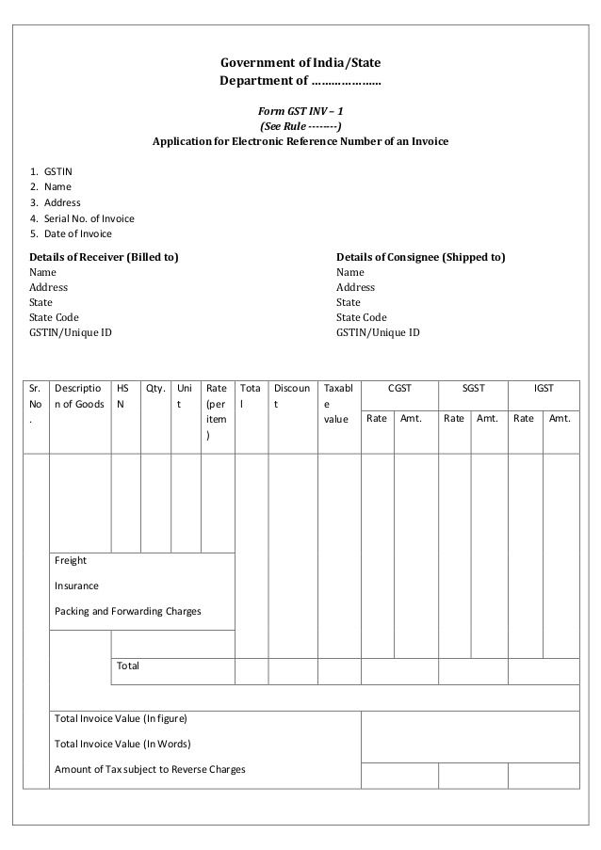
GST INVOICE FORMAT

Slide 18
RETURNS UNDER GST
Following are the various forms for return under GST .
GSTR-1- Outward supplies made by taxpayer (other than compounding taxpayer and ISD) this is to be filled 10th of the next month.
GSTR-2- Inward supplies received by a taxpayer (other than a compounding taxpayer and ISD). This is to be filled 15th of the next month.
GSTR-3- Monthly return (other than compounding taxpayer and ISD). this is to be filled on 20th of the next month.
GSTR-4- Quarterly return for compounding Taxpayer. This is to be filled on 18thof the month next to quarter.

Slide 19
RETURNS UNDER GST(cont…)
GSTR-5- Periodic return by Non-Resident Foreign Taxpayer . This is to be filled on Last day of registration.
GSTR-6- Return for Input Service Distributor (ISD). This is to be filled on 15th of the next month .
GSTR-7- Return for Tax Deducted at Source . This is to be filled on 10th of the next month.

Slide 20
PENALTIES UNDER GST
There are 21 offences under GST apart from the penalty under section 8 covering fake/wrong invoices, fraud, tax evasion and others. A few are mentioned here.
(i) Supply of any goods/services without any invoice or issue of a false invoice.
(ii) Issue of invoices by a taxable person using the identification number of other bona fide taxpayer(s).
(iii) Submission of false information while registering under GST.
(iv) Submission of fake financial records/documents or files, or fake returns to evade tax.
(v) Obtaining refunds by fraud.
(vi) Deliberate suppression of sales to evade tax.
(vii) Non-registration under GST by a taxpayer, although required to by law.
(viii) Opting for composition scheme even though a taxpayer is ineligible.

Slide 21
PENALTIES UNDER GST(CONT..)
For cases with no intention of fraud or tax evasion
An offender not paying tax or making short payments has to pay a penalty of 10% of the tax amount due subject to a minimum of Rs. 10,000.
For cases of fraud
An offender has to pay a penalty amount of tax evaded/short deducted etc., i.e., 100%penalty, subject to a minimum of Rs. 10,000.

Slide 22
PENALTIES UNDER GST(CONT..)
Additional penalties as follows-
Tax amount involved | 50 lakhs | 100 lakhs | 250 lakhs
Jail term | Upto 1 year | Upto 3 years | Upto 5 year
Fine | In all three cases

Slide 23
PENALTIES UNDER GST(CONT..)
INSPECTION UNDER GST
If Joint Commissioner of SGST/CGST (or a higher officer) “has reasons to believe” that –
In order to evade tax, a person has suppressed any transaction or claimed excess input tax credit etc., then he can authorize any other officer of CGST/SGST (in writing) to inspect places of business.
SEARCH & SEIZURE UNDER GST
Joint Commissioner of SGST/CGST can order for a search on the basis of results of inspection or any other reason, if he has “reasons to believe”
(i) There are goods which are liable for confiscation
(ii) Any documents or books or other things which will be useful during proceedings and are hidden somewhere.

Slide 24
PROSECUTION UNDER GST
A person committing an offence with the deliberate intention of fraud, becomes liable to prosecution, i.e., face criminal charges. A few examples of these offences are-
(i) Issue of an invoice without supplying any goods/services- thus taking input credit or refund by fraud
(ii) Obtaining refund of any CGST/SGST by fraud.
(iii) Submitting fake financial records/documents or files, and fake returns to evade tax.
(iv) Helping another person to commit fraud under GST.

Slide 25
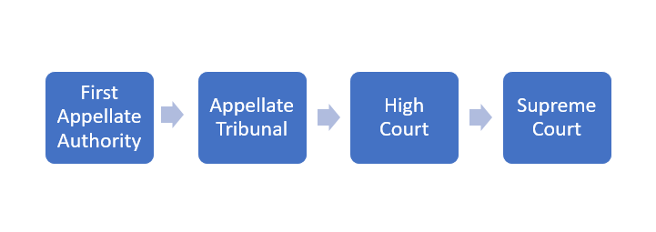
APPEALS UNDER GST

